Slide 1

Chapter 14

Slide 2

Network & Goals
A network is an interconnected collection of autonomous computers that can share and exchange information. Major reasons that emphasize on the need of networks are :
Resource Sharing
Reliability
Reduced Costs
Fast Communicaton

Slide 3
Evolution of Networking
Evaluation of networking started way back in 1969 by the development of first network called ARPANET(Advanced Research Projects Agency NETwork) used by U.S. Department of Defence. The aim of project was to connect computers at different universities and U.S. defence.
In 1980s, NSFnet was started to make a high capacity network to be used strictly for academic and engineering research.
In 1990s the internetworking of ARPANET, NSFnet and other private networks resulted into Internet.

Slide 4
INTERNET
The Internet is a worldwide network of computer networks. The internet is a super-network. It connects many smaller networks together and allows all the computers to exchange information with each other.
To accomplish this all the computers on the Internet have to use a common set of rules for communication. Those rules are called as protocols and the Internet uses a set of protocols called TCP/IP (Transmission Control Protocol/Internet Protocol).

Slide 5
TCP/IP
TCP : Transmission Control Protocol is responsible for dividing the file/message into packets on the source computer and is also responsible for reassembling the received packets at the destination or recipient computer.
IP : Internet Protocol : is responsible for handling the address of destination computer so that each packet is routed (sent) to its proper destination.
Interspace is a Client/Server software program that allows multiple users to communicate online with real-time audio, video and text chat in dynamic 3D environment.

Slide 6
Elementary Terminology of Networks
Nodes(Workstations)
Server : A computer that facilitates the sharing of data, software, and hardware resources (e.g. printers, modems etc.) on the network is termed as a Server.
Types of Servers :
Non-dedicated Servers
Dedicated Servers.
Network Interface Unit (NIU) : is an interpreter that helps establish communication between the server and worksatations.
The MAC (Media Access Control) address refers to the physical address assigned by NIC manufacturer.

Slide 7
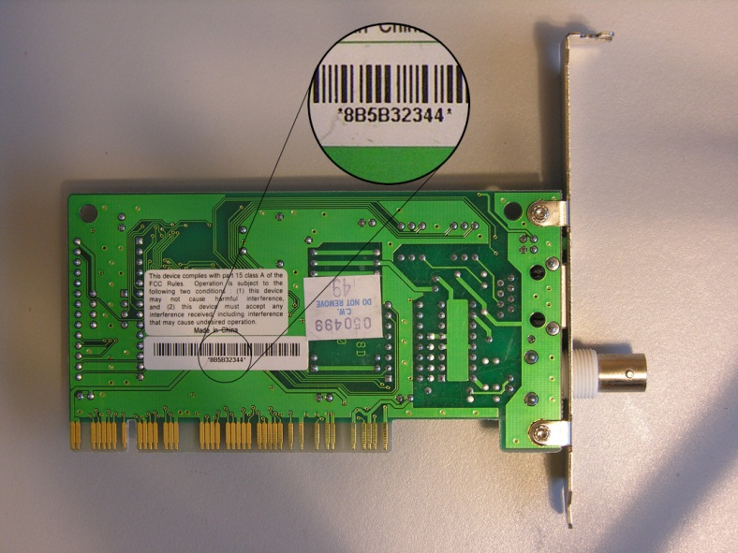
MAC Address

Slide 8
Switching Techniques
Circuit Switching : In this technique, first the complete physical connection between two computers is established and then data are transmitted from the source computer to the destination computer.
Message Switching : In this form of switching no physical copper path is established in advance between sender and receiver. Instead when the sender has a block of data to be sent, it is stored in first switching office, then forwarded later, one jump at a time.
Packet Switching : In message switching there is no limit on block size, in contrast, packet switching places a tight upper limit on block size. A fixed size of packet which can be transmitted across the network is specified.

Slide 9
Transmission Media
Transmission/Communication media can be categorized into two categories :
1. Guided Media : includes cables
2. Unguided Media : include waves through air, water or vacuum.
Guided Media :
Twisted Pair Cable : These cables consist of two insulated copper wires twisted around each other. These are also used for short and medium range telephone communication. Available types in market are : CAT1, CAT2…CAT5

Slide 10
Coaxial Cables : A coaxial cable consists of one or more small cables in protective covering. These are more expensive than twisted pair cables but perform better. It can be used for broadband transmission i.e. several channels can be transmitted simultaneously (as with cable TV). Offer higher bandwidth upto 400 MBPS. Type of Coaxial cable :
Thicknet : cable segment can be upto 500 meters long
Thinnet : is thineer & max. segment upto 185 meters.
Optical Fibre Cables : These cables are made of plastic or glass and are about as thick as human hair. These cables are highly durable and offer excellent performance but are expensive.
Types :
Multinode : segment length : 2 Kms, 100 Mbps, expensive
Singlenode : segment length : 100 Kms, 2 Gbps, exp.

Slide 11
Unguided Media
Micro Wave : Microwave signals are similar to radio and television signals and are used for long distance communication. The microwave transmission consists of a transmitter, receiver and the atmosphere. In microwave communication parabolic antennas are mounted on towers to send a beam to other antennas tens of kilometers away.
Radio Wave : transmission making use of radio frequencies is termed as radio-wave transmission and any radio setup has two parts : transmitter and receiver. The transmitter takes some sort of message, encodes it onto a sine wave and transmits it with radio waves. The receiver receives the radio waves and decodes the message from the sine wave it receives.

Slide 12
Unguided Media
Satellite Communication : In satellite communication the earth station consists of a satellite dish that functions as an antenna and communication equipment to transmit and receive data from satellites. A number of communication satellites, owned by both governments and private organizations, have been placed in stationary orbits about 22,300 miles above the earth’s surface.
The satellites accept data/signals transmitted from an earth station, amplify them and retransmit them to another earth station.
Other unguided media : Infrared and Laser.

Slide 13
Data Communication Terminologies
Data Channel : A channel is the medium used to carry information or data from one point to another.
Baud : It is the unit of measurement for the information carrying capacity of a communication channel. The baud is synonymous with bps (bits per second), another unit of measuring data transfer rates.
Bits Per Second (bps) : refers to the speed at which data transfer is measured.
B-Bytes per second ; b- bits per second
kbps- thousand bits per second, Kbps-kilo bytes per sec.
mbps-million bits per second, Mbps-million bytes per sec.
Bandwidth : Amount of digital information that can be pushed through a channel is bandwidth. It is directly proportional to the amount od data transmitted or received per unit time. Higher bandwidth channels are called broadband channels.

Slide 14
Types of Networks
LAN (Local Area Network)
MAN (Metropolitan Area Network)
WAN (Wide Area Network)
Network Topologies : The pattern of interconnection of nodes in a network is called the Topology.
Types :
Star, Bus, Ring or Circular, Tree, Graph, Mesh

Slide 15
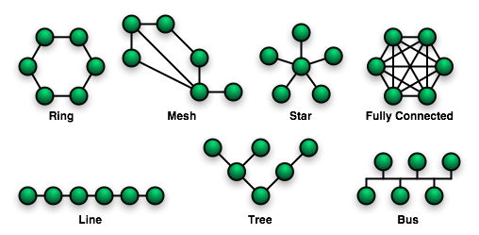
Bus or linear Topology

Slide 16
Bus or Linear Topology
In this topology, all devices on network are connected to a single continuous cable called a bus. Transmission from any cable travels the length of the bus in both directions and can be received by all other stations. The destination device, on identifying the address of data packet copies the data onto its disk. When the data packet reaches at either end the terminator on that end absorbs the signal, removing from the bus. This topology can be used for smaller networks.
Advantages : Short cable length and simple wiring layout, Resilient Architecture, Easy to extend
Disadvantages : Fault diagnosis is difficult, Fault isolation is difficult, Repeater Configuration, Nodes must be intelligent

Slide 17
Ring or Circular Topology
In this topology each node is connected to two and only two neighboring nodes. Data is accepted from one of the neighboring nodes and is transmitted onwards to another. Thus the data travels in one direction only, from node to node around the ring. After passing through each node, it returns to the sending node, which removes it.
Advantages : Short cable length, No wiring closet space required, Suitable for optical fibres.
Disadvantages : Node failure causes network failure, Difficult to diagnose faults, Network reconfiguration is difficult.

Slide 18
The Star Topology
This topology consists of a central node to which all other nodes are connected by a single path. It is the topology used in most existing information networks involving data processing or voice communications.
Advantages : Ease of service, one device per connection, centralized control, simple access protocols
Disadvantages : Long cable length, Difficult to expand, Central node dependency.

Slide 19
Network Devices
Modem : stands for Modulator Demodulator is a computer peripheral that allows you to connect and communicate with other computers via telephone lines.
It converts digital signals to A/F(Audio Frequency) tones which are in the frequency range that the telephone lines can transmit and also it can convert transmitted tones back to digital information.
RJ-45 : is short for Registered Jack-45. It is an eight-wire connector, which is commonly used to connect computers on the LANs.
Ethernet Card : Ethernet is a LAN architecture developed by Xerox Corp in association with Intel. Ethernet uses Bus or Star topologies and can support data transfer rates of up to 10 Mbps.

Slide 20
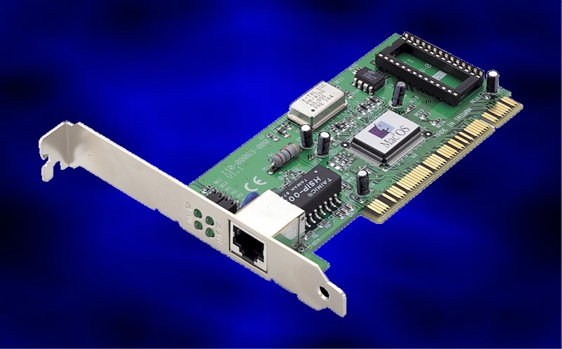
Ethernet Card

Slide 21
Hub
A hub is a hardware device used to connect several computers together. Hubs can be active or passive.
Active hubs electrically amplify the signal as it moves from one connected device to another.
Passive hubs allow the signal to pass from one computer to another without any change. Hubs usually can support 8,12, or 24 RJ-45 slots.
Drawbacks :
Broadcasting of data to all nodes.
Do not filter network traffic.
Bandwidth is shared among all attached devices.

Slide 22
Switch
A switch is a device that is used to segment networks into different subnetworks, called subnets or LAN segments. Segmenting the network into smaller subnets, prevents traffic overloading in a network.
A switch is responsible for filtering i.e. transforming data in a specific way and for forwarding packets between LAN segments
Repeater : is a network device that amplifies and restores signals for long-distance transmission.
Bridge : is a network device that establishes an intelligent connection between two local networks with the same standard by different types of cables.
Router : is a network device that is used to separate different segments in a network to improve performance and reliability. A router works like a bridge but can handle different protocols.

Slide 23
Gateway
A Gateway is a network device that connects dissimilar networks. It establishes an intelligent connection between a local network and external networks with completely different structures.

Slide 24
LAN Design
Good Network Design : 80-20 Rule : 80 percent of the traffic on a given network segment is local and not more than 20 percent of the network traffic should need to move across a backbone (the spine that connects various segments or subnetworks).
Combining Hubs, Switches and Routers :
Hubs share bandwidth among all attached devices and cannot filter traffic. They broadcast data to all devices.
Bridge can filter network traffic based on MAC addresses and insure that traffic goes only to intended segment and not to all segments as with the hubs.
A switch can replace bridge but cannot stop traffic designated for a different LAN segment from travelling to all other LAN segments.
Router filter network traffic based on IP addresses. The IP address tells the router which LAN segment the network traffic belongs to.

Slide 25
Protocols
Protocol means the rules that are applicable for a network. Protocol defines standardized formats for data packets, techniques for detecting and correcting errors and so on.
Different protocols :
HTTP (Hypertext Transfer Protocol) : is an application level protocol with the lightness and speed necessary for distributed, collaborative, hypermedia information systems.
FTP (File Transfer Protocol) : allow for transmission of files from one system to another. Files of any type can be transferred using this protocol.
TCP/IP
Datagram : is a collection of the data that is sent as a single message.

Slide 26
Protocols
SMTP (Simple Mail Transfer Protocol)
POP/POP3 (Post Office Protocol) : used for receiving mails on PCs.
IMAP (Interactive Mail Access Protocol) : most common in business environments.
VOIP (Voice Over Internet Protocol) : for delivering voice communications and multimedia sessions over internet.
IRC (Internet Relay Chat) : most common chat protocol
SIP (Session Initiation Protocol) : IP telephony signaling protocol used to establish, modify and terminate VOIP telephone calls.

Slide 27
Protocols
SLIP/PPP (Serial Line Internet Protocol) was the first protocol for relaying IP packets over dial-up lines.
PPP (Point to Point Protocols) : is the internet standard for transmission of IP packets over serial lines. PPP is currently best solution for dial-up Internet connections. It is a layered protocol.
Wireless communication : is simply data communication without the use of landlines. Mobile computing means that the computing device is not continuously connected to the base or central network.
GSM is short for Global System for Mobile communications which is one of the leading digital cellular systems. GSM users simply switch subscriber identification module (SIM) cards which stores all the connection data and identification numbers needed to access a particular wireless service provider.

Slide 28
Mobile Computing
CDMA is short for Code-Division Multiple Access, a digital cellular technology. CDMA uses spread-spectrum technique where data is sent in small pieces over a number of discrete frequencies available for use. Each user’s signal is spread over the entire bandwidth by unique spreading code. At the receiver end, the same unique code is used to recover the signal.
WLL (Wireless Local Loop) is system that connects subscribers to the public switched telephone network (PSTN) using radio signals as a substitute for other connecting media.

Slide 29
Mobile Computing
3G : is specification for 3rd Generation of mobile communication technology. It is broadband, packet-based transmission of text, digitized voice, video and multimedia at data rates upto and possible higher than 2 mbps.
SMS : Short Message Service is the transmission of short text message to and from a mobile phone, fax machine and/or IP address.
E-mail, Voice Mail, Chat
Video Conferencing : A two-way conversation among multiple participants is called Video Conferencing.
Telnet : is an Internet utility that lets you log onto remote computer systems.
url: http://www.lights.com/htelnet/

Slide 30
FREE SOFTWARE
Freely accessible
Freely used
Freely changed,improved.
Freely copied and distributed
No payments required to be made
Source code is available

Slide 31
OPEN SOURCE SOFTWARE
Freely accessible
Freely used
Freely changed,improved.
Freely copied and distributed
Payments may or may not required to be made
Source code is available.

Slide 32
FLOSS (Free Libre and Open Source Software)
Software which is both free software as well as open source software. Libre means freedom.

Slide 33
GNU(Not Unix)
GNU Project was initiated by Richard M. Stallman.
Its main motive was to create a system compatible to Unix but not identical with it.
Now this project is not limited to OS only.
Its an OSS

Slide 34
FSF (Free Software Foundation)
A non profit organization founded by Richard Stallman in 1985 to support GNU project and GNU licences.

Slide 35
OSI ( Open Source Initiative)
An organization founded by Bruce Perens and Erics Raymond in Feb. 1998 to promote OSS.
It properly defines the terms and specifications of OSS.

Slide 36
Proprietory Software
Neither open nor freely available.
Source code not available.
Further distribution and modification is either forbidden or requires special permission by the supplier or vendor.

Slide 37
Freeware
Freely accessible
Freely used
No modifications can be made.
Freely copied and distributed
No payments required to be made
Source code not available.
Freeware is often used in marketing situations in order to sell additional products. E.g. Microsoft Internet Explorer

Slide 38
Shareware
Freely accessible
Freely used
No modifications can be made.
Freely copied and distributed
A license fee has to be paid after a certain period of time e.g. antivirus
Source code not available.
Its objective is to make the software available to try for as many users as possible.

Slide 39
Web Browser & Web Server
A Web Browser is a WWW client that navigates through the World Wide Web and displays web pages.
A Web Server is a WWW server that responds to the requests made by web browsers.
WWW is a set of protocols that allows you to access any document on the Net through a naming system based on URLs.
The characters based naming system by which servers are identified is known as Domain Name System (DNS).
A URL (Uniform Resource Locator) specifies the distinct address for each resource on the Internet. An Internet address which is character based is called a Domain Name.
A location on a net server is called a Web Site. A document that uses HTTP is called a Web Page.

Slide 40
Web Hosting
Web Hosting is a means of hosting web-server application on a computer system through which electronic content on the Internet is readily available to any web-browser client.
HTML (Hypertext Markup Language) is a document-layout and hyperlink-specification language i.e. a language used to design the layout of a document and to specify the hyperlinks. HTML tells the browser how to display the contents of a hypertext document i.e. Document including text, images and other support media.

Slide 41
DHTML
DHTML refers to Web content that changes each time it is viewed. E.g. the same URL could result in a different page depending on any number of parameters, such as :
Geographic location of the reader
Time of day
Previous pages viewed by the reader
Profile of the reader

Slide 42
XML
XML (extensible markup language) is a markup language for documents containing structured information which contains both content (words, pictures etc.) and some indication of what role that content plays (e.g. content in a section heading has a different meaning from content in a footnote.
Web Scripting : A script is a list of commands embedded in a web-page. Scripts are interpreted and executed by a certain program or scripting-engine.
Client-Side Scripts : Client-side scripting enables interaction within a web page. Client-side scripts are downloaded at the client-side and then interpreted and executed by the browser.
E.g. some popular Client-side scripting languages are VBScript, JavaScript, Hypertext Preprocessor (PHP).

Slide 43
Web Scripting
Examples of Client-Side Scripting : to get data from user’s screen or browser, online games etc.
Server-Side Scripting : enables the completion or carrying out a task at the server-end and then sending the result to the client-end.
Some popular Server-side Scripting languages are : PHP (Hypertext Preprocessor), Perl, ASP (Active Server Pages), JSP( Java Server Pages) etc.
E.g. Form processing, password protection etc.

Slide 44
Network Security
Firewall : the system designed to prevent unauthorized access to or from a private network is called firewall.
Cookies : are messages that a Web server transmits to a Web browser so that the Web Server can keep track of the user’s activity on a specific Web Site.
Hackers and Crackers : The Crackers are the malicious programmers who break into secure systems whereas Hackers are more interested in gaining knowledge about computer systems and possibly using the knowledge for playful pranks.
Cyberlaw : is a generic term, which refers to al the legal and regulatory aspects of Internet and the World Wide Web.

Slide 45
Cyber Crime
Cyber Crime is understood as “ an unlawful act where in the computer is either a tool or a target or both”.
Classification of Cyber Crimes : The IT Act deals with following Cyber Crimes along with others :
Tampering with computer source documents
Hacking : unauthorized access of a system
Publishing of information, which is obscene in electronic form
Child Pornography
Accessing protected system
Breach of confidentiality and privacy: any person accessing any electronic record, book, reg.,information, doc. Or other material without the consent of the person concerned.

Slide 46
IT Act
An act to provide legal recognition for transactions carried out by means of electronic data interchange and other means of electronic communication, commonly referred to as “electronic commerce”, which involves the use of alternatives to paper based methods of communication and storage of information, to facilitate electronic filling of documents with the government agencies and further to amend the Indian Penal Code, the Indian Evidence Act, 872, the Bankers Book Evidence Act, 1891 and the Reserve Bank of IndiaAct, 1934 and for matters connected therewith or incidental thereto;
In India cyber laws are enforced through IT Act,2000 and its prime purpose was to provide legal recognition to electronic commerce and to facilitate filing of electronic records with the Govt. It was amended in Dec. 2008

Slide 47
Web 2.0
Web 2.0 refers to added features and applications that make the web more interactive, support easy online-information exchange and interoperability. Some noticeable features of Web 2.0 are blogs, wikis, video-sharing websites, social networking websites etc.

Slide 48
VIRUSES
Computer Virus is a malicious program that requires a host an designed to make a system sick, just like a real virus.
Following are characteristics of a computer virus :
It is able to replicate.
It requires a host program as a carrier.
It is activated by external action.
Its replication ability is limited to the system.
Trojan Horses : A Trojan Horse is code hidden in a program such as a game or spreadsheet that looks safe to run but has hidden side effects.
Trojan Horses generally are spread through e-mail and exchange of disks and information between computers.
Worms : A worm is a program designed to replicate. Worms are programs that run independently and travel from computer to computer across network connections.
Spam : Spam refers to electronic junk mail or any unsolicited e-mail.

Slide 49
Virus
Broadly 3 types of viruses are :
File infectors – attach themselves to a program file
Boot sector virus – install themselves on the beginning tracks of a hard drive.
Macro viruses – infect data files.
Damages caused by Viruses :
Can destroy FAT which lead to corruption of entire file system resulting reinstallation of OS
Can create bad sectors,destroing parts of programs and files.
Can decrease disk space by duplicating files.
Can format entire disk space.
Can destroy specific executable files
Can cause the system to hang

